Slide 1
Advanced Concepts Java - Assignment III
BY: Rishika Kumari
1852

Slide 2
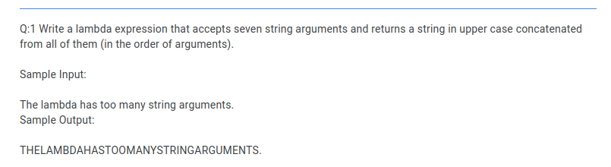

Slide 3
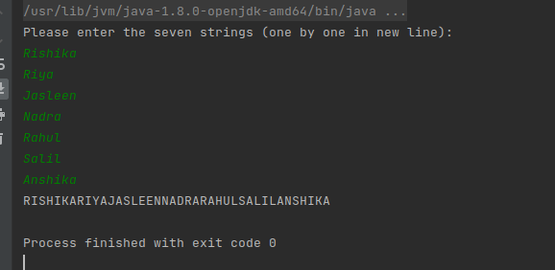
Outputs:

Slide 4
THANK YOU!

